Slide 1
Revenue update
August 14, 2025
Presented by:
Kriscinda Hansen, CFO

Slide 2
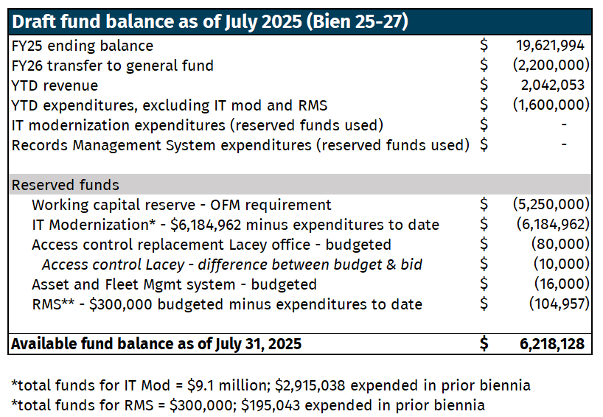
Draft fund balance
Notes:
July’s projected revenue was $2.593 million
Draft actual: $2.043 million

Slide 3
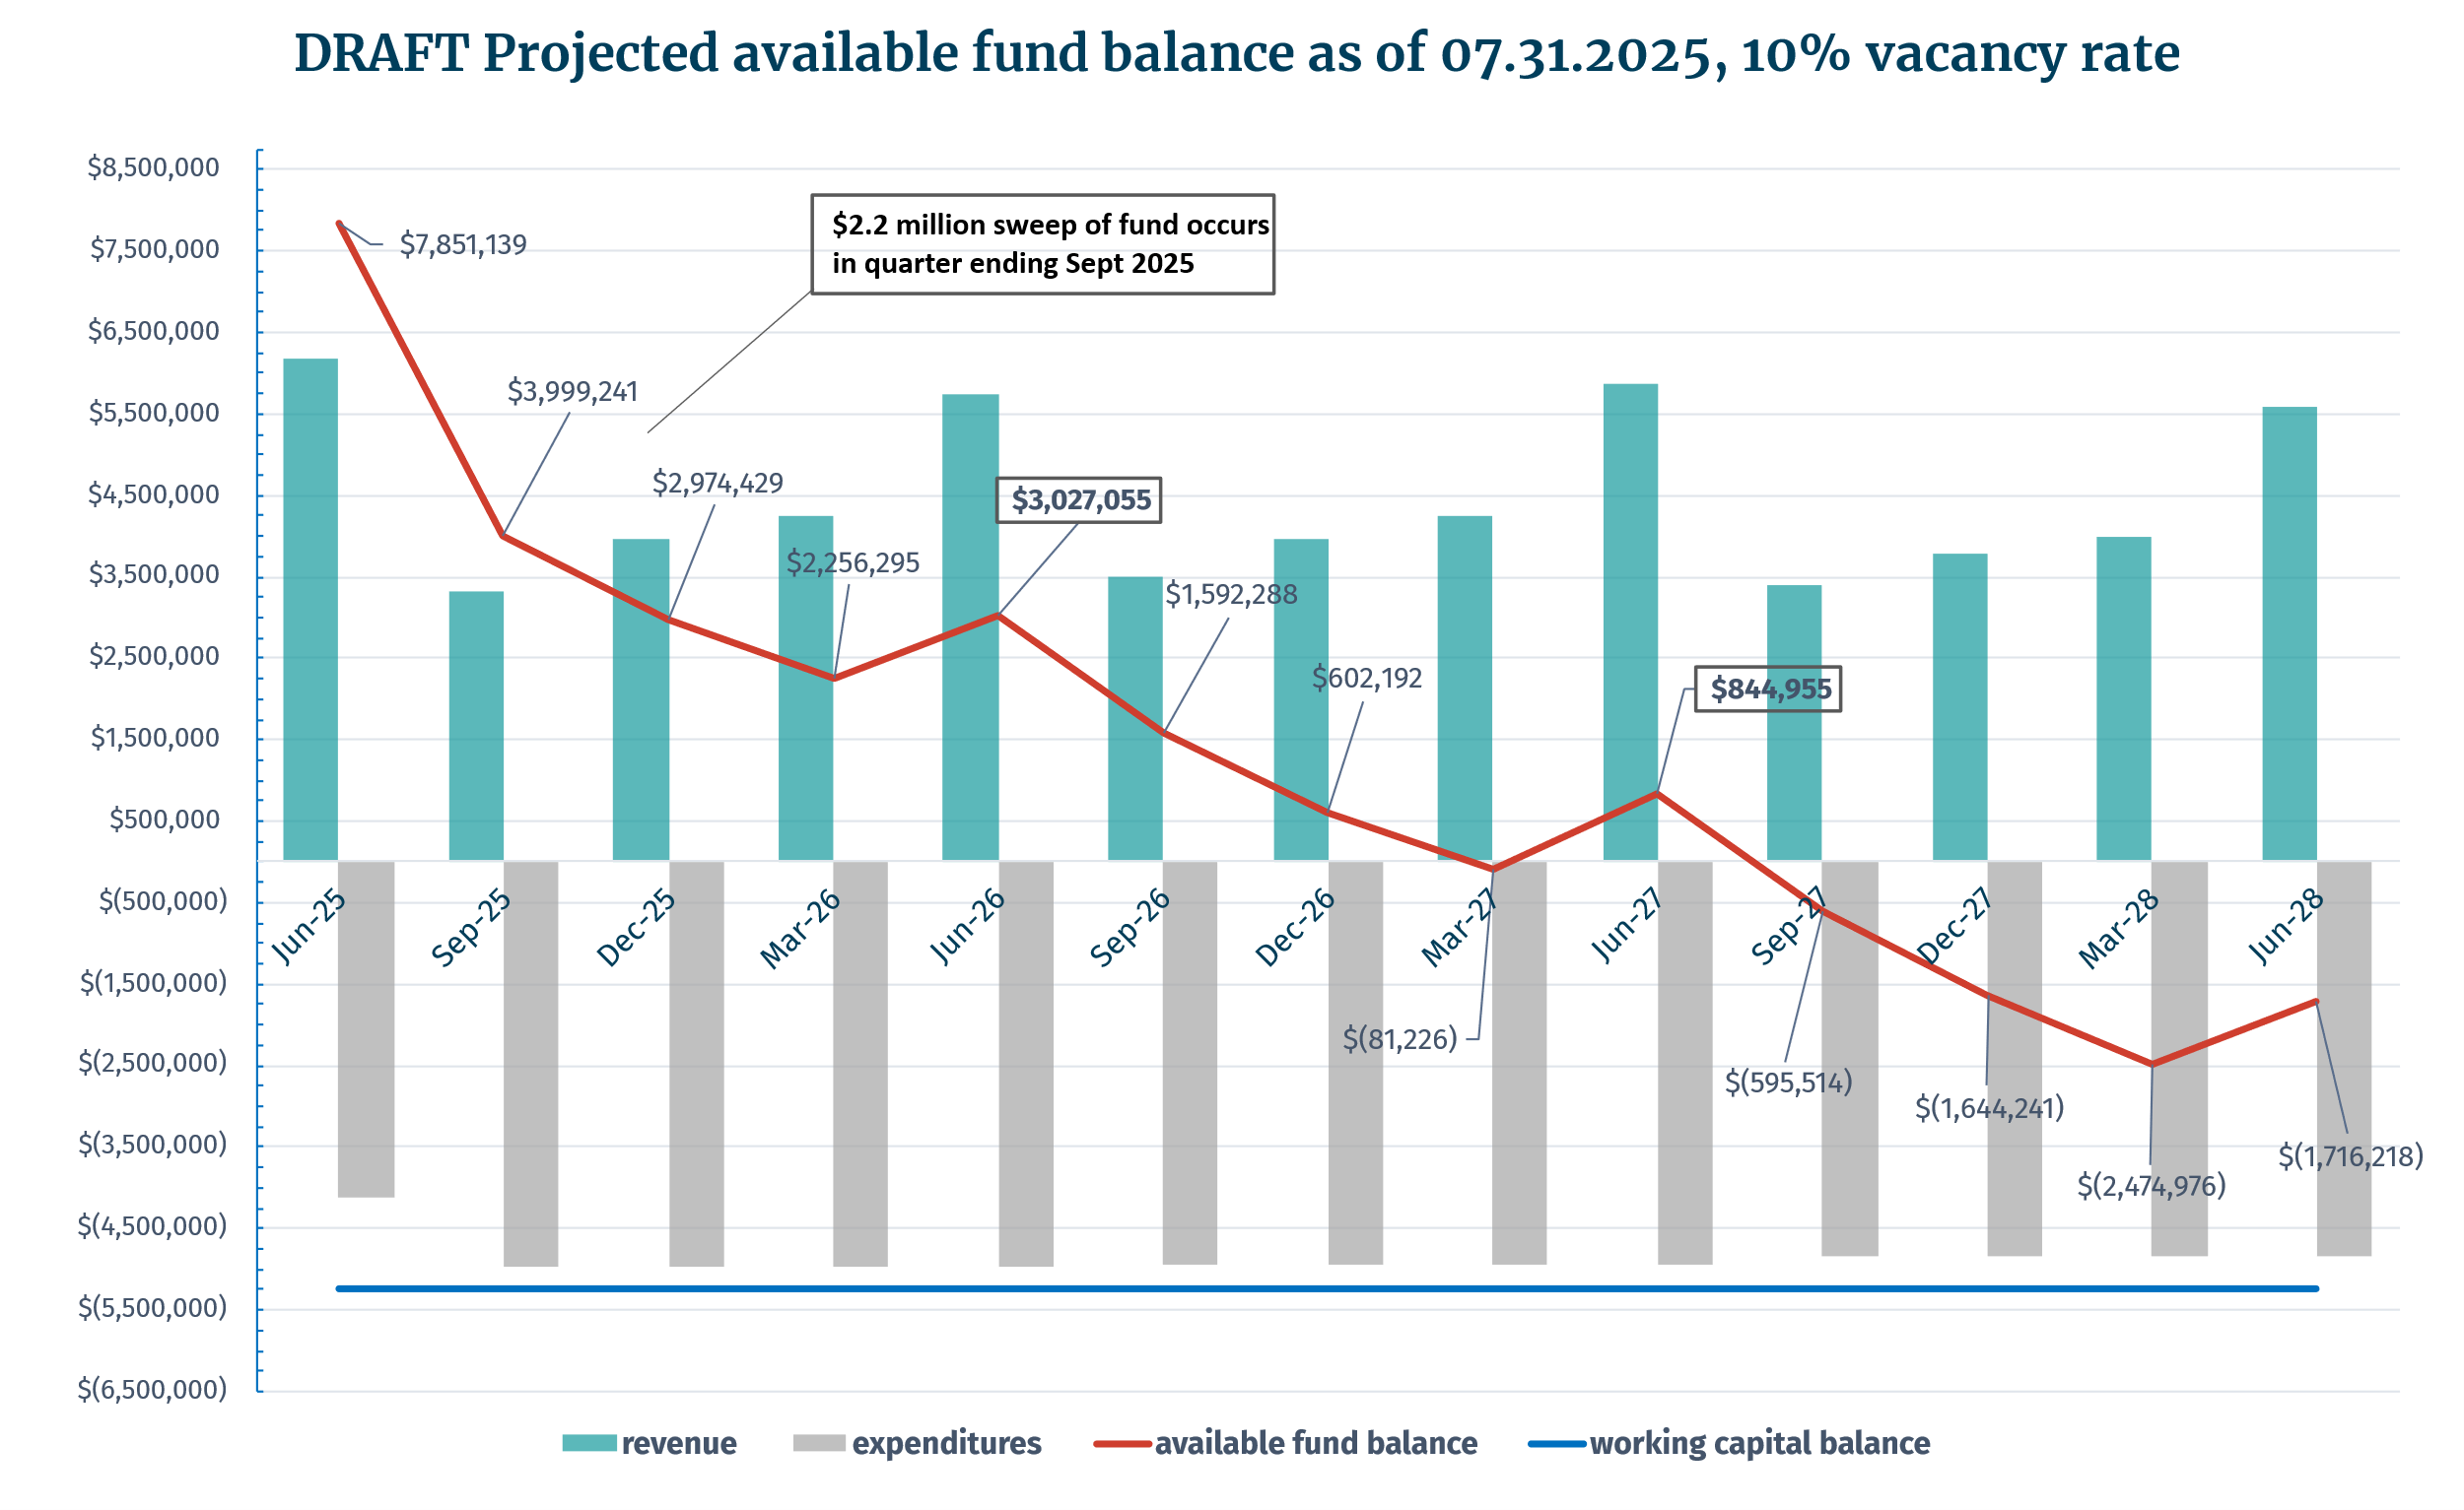

Slide 4
Questions
Kriscinda Hansen, Chief Financial Officer

