Slide 1
Budget update
February 20, 2025
Presented by:
Kriscinda Hansen, CFO

Slide 2
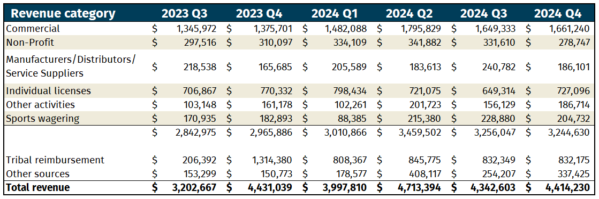
Revenue over time by category
Notes:
Sports Wagering includes vendors, reps, and licensing investigation reimbursement
Tribal reimbursement includes Regulatory billing and NAT payments
Other includes fines, fees, and EGL billing

Slide 3
Revenue over time – Commercial, Manufacturer, Distributor, Service Supplier
Notes:
Does not include Manufacturer special sales permit or PBPT service business supplier permit

Slide 4
Revenue over time – Non-profit

Slide 5
Revenue/expenditure comparison over time
IT modernization expenditures are not included in this summary.

Slide 6
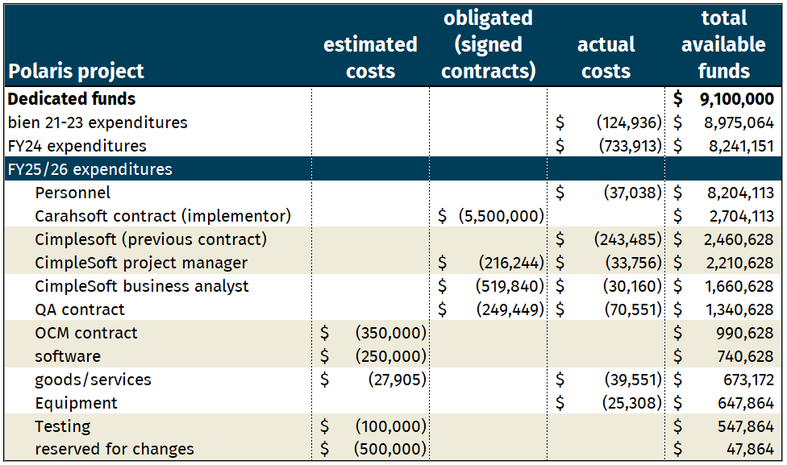
IT modernization costs

Slide 7
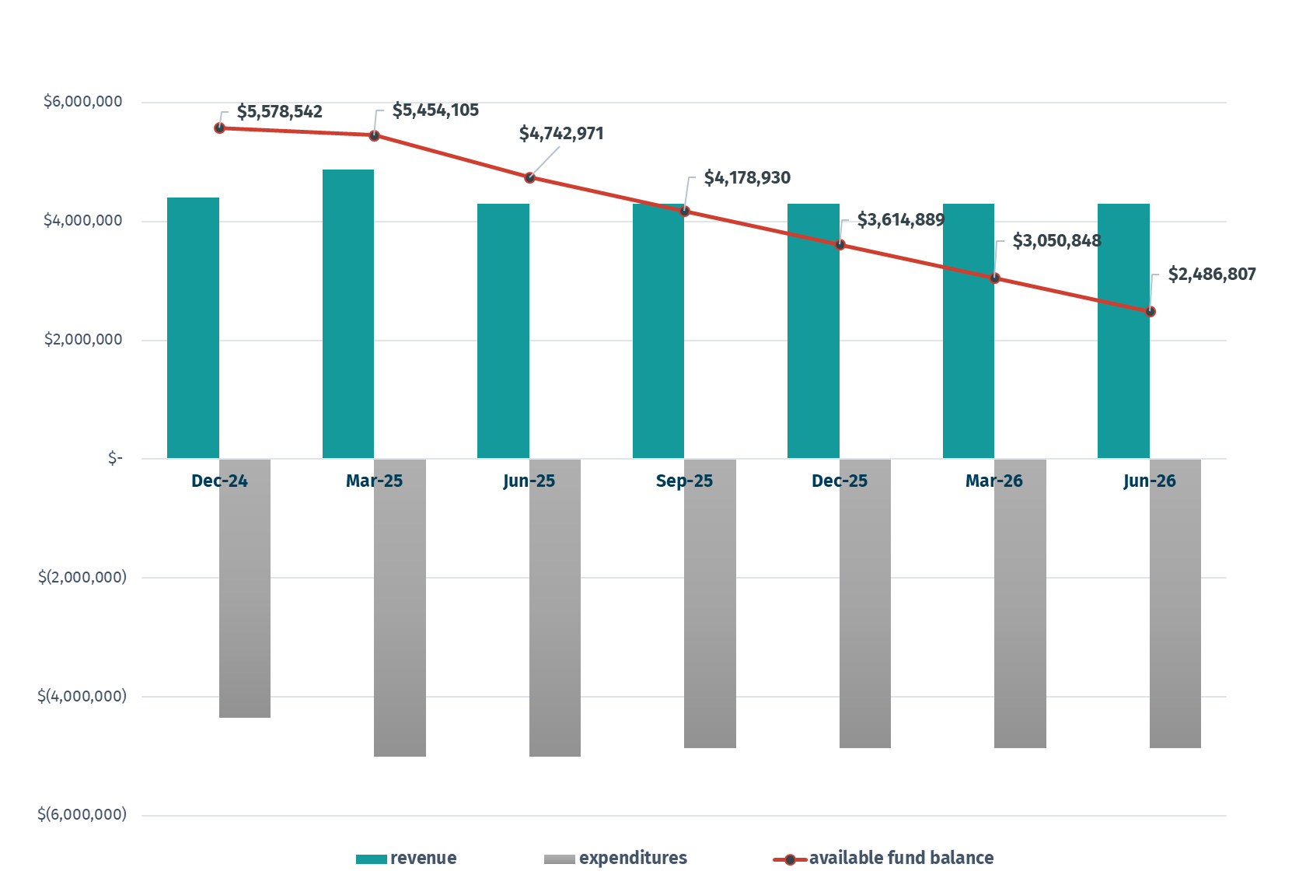
Projected available fund balance, 10% vacancy rate, preliminary
Notes:
Shows a 10% vacancy rate; in general (11 positions), 8-10% is standard
Reminder:
Revenue estimate is based on 12-month average revenue
Expenditures through current month are actual with July estimated; July 25 forward is an estimate; budget has not yet been submitted
The ongoing costs for the software solution are unknown, but we do know we will be required to pay fees for external users to use the system

Slide 8
Questions
Kriscinda Hansen, Chief Financial Officer

